Slide 1
Power BI DASBOARD-Retail Sales analysis
Yeshashwini G
26th June,2025

Slide 2
Objective
To design an interactive dashboard using Power BI
To analyze retail sales performance using KPI’s and visualizations
To help business stakeholders make data-driven decisions

Slide 3
Key insights from the dashboard
Total Sales : INR 4,56,000
Highest sales in “Electronic” category
Sales trend peaked in December
Line chart shows consistent monthly growth
Users can filter by product category using slicers

Slide 4
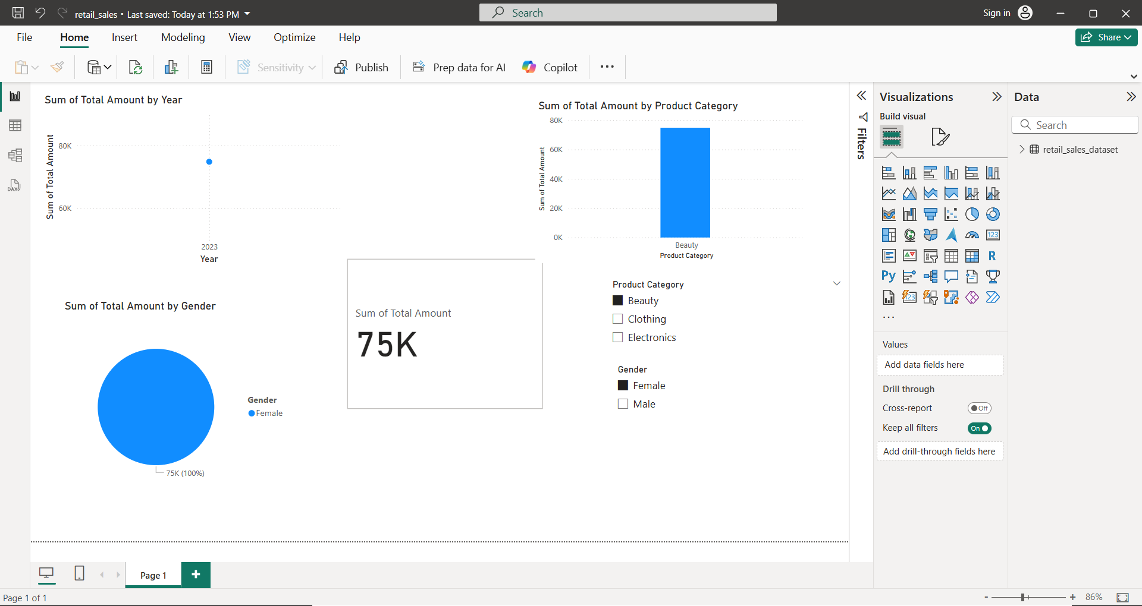
Power bi dashboard preview

Slide 5
conclusion
Created an interactive, visual dashboard
Delivered KPI’s using Card , Line, Bar, and Pie charts
Applied slicers for real-time filtering
Enhanced stakeholder decision-making capability+

